Slide 1
Distributed Services Dependency Discovery from Log
Project Proposer: Wenbo Qian
Mentors: Alison Yao

Slide 2
Previous Progress:
Building Service Dependency from Log
Service 2
Resource 1
Op 2.1
[
{"
"service_a",
"operation_a",
"service_b",
"operation_b",
"resource",
"},
…
]
Op 1.1
Service 1
Op 1.3
Resource 3
Op 3.2
Op 1.2
Service 3
Resource 2
Op 3.1

Slide 3
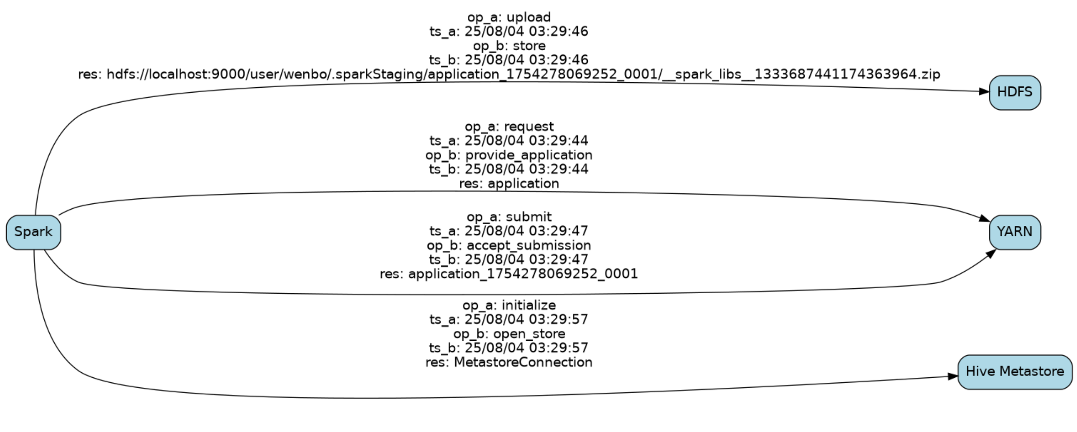
Previous Progress:
Preliminary Result

Slide 4
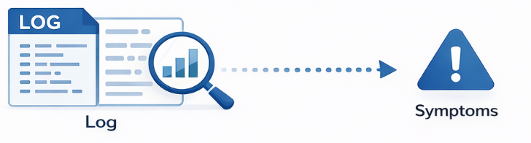
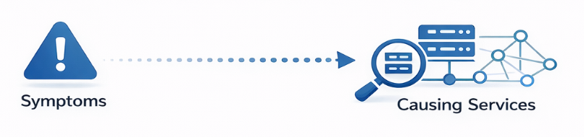
Goal: Discover Anomaly Services from Log
Challenge 1: How to automatically identify symptoms from logs?
Challenge 2: How to automatically connect the symptom to its root-cause service?

Slide 5
Challenge 1: Automatically Identify Symptoms from Logs
Different forms of symptoms:
Error exception
Abnormal execution time
Excessive resource usage
Prior work on identifying symptoms:
Rely on users input:
Relational Debugging (OSDI ’23)
”Perspect takes the symptoms (such as a program counter that indicates excessive memory usage or a function with abnormal execution time) as inputs.”

Slide 6
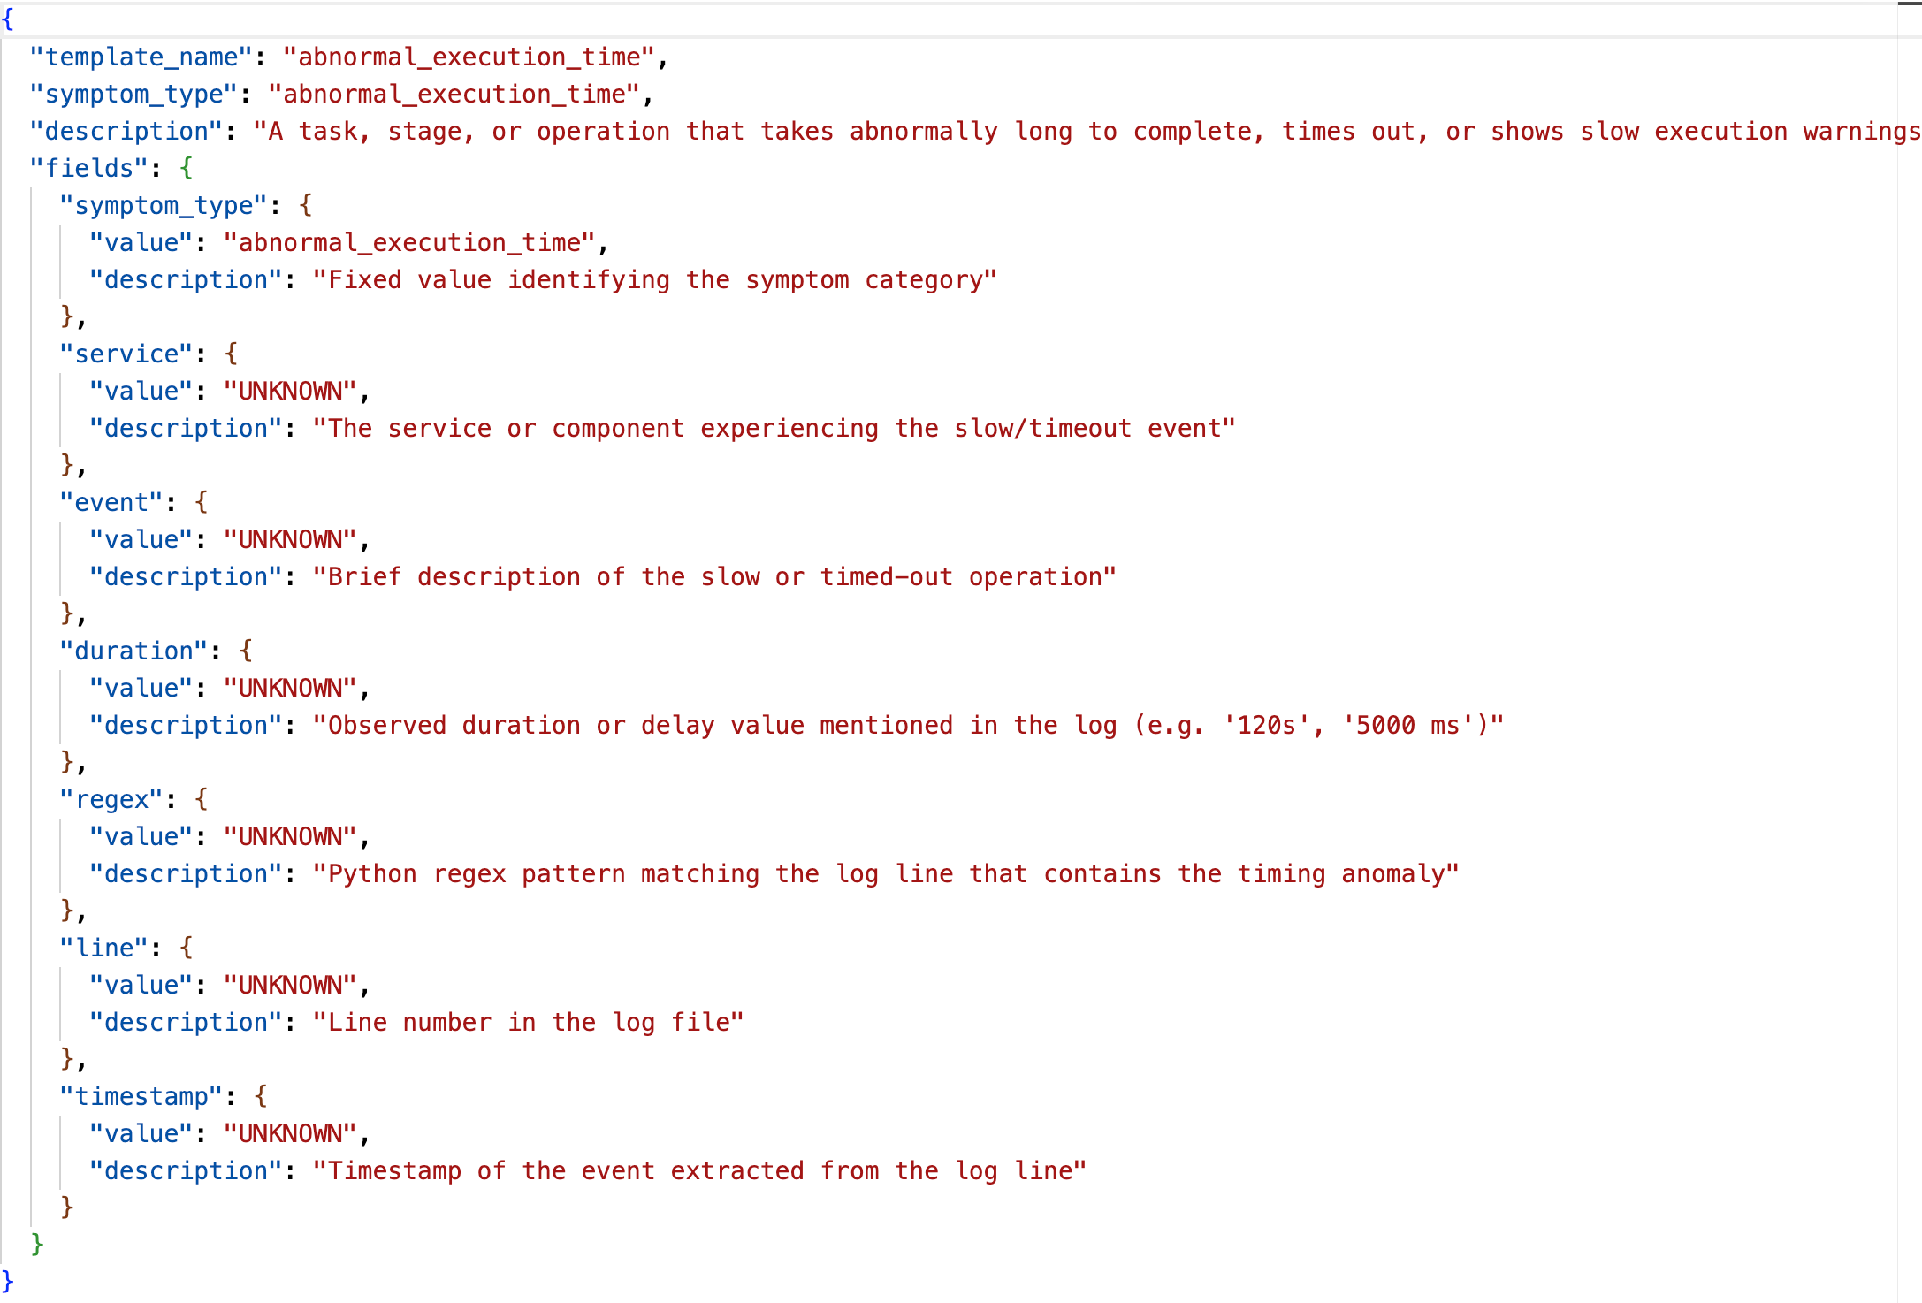
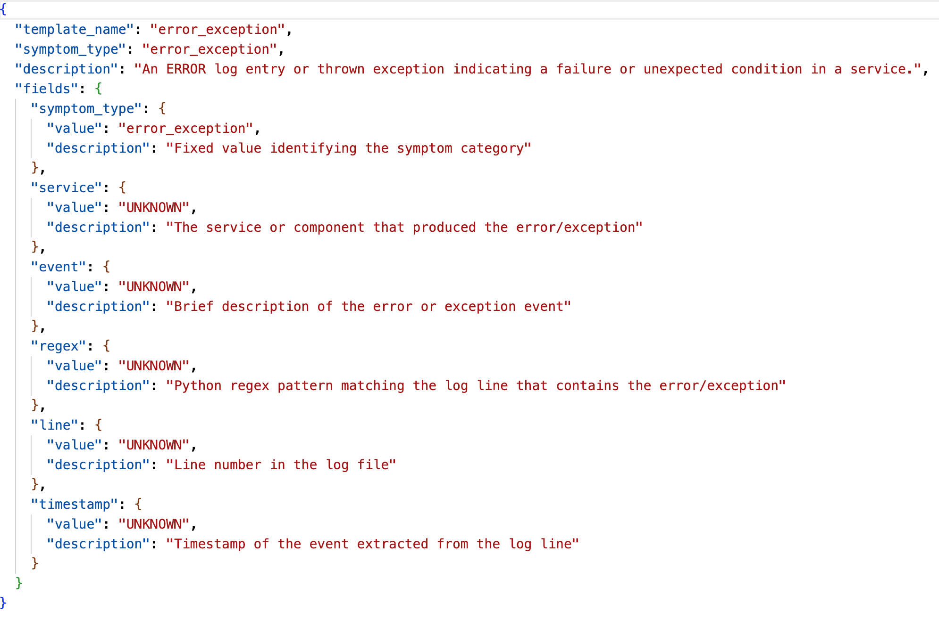
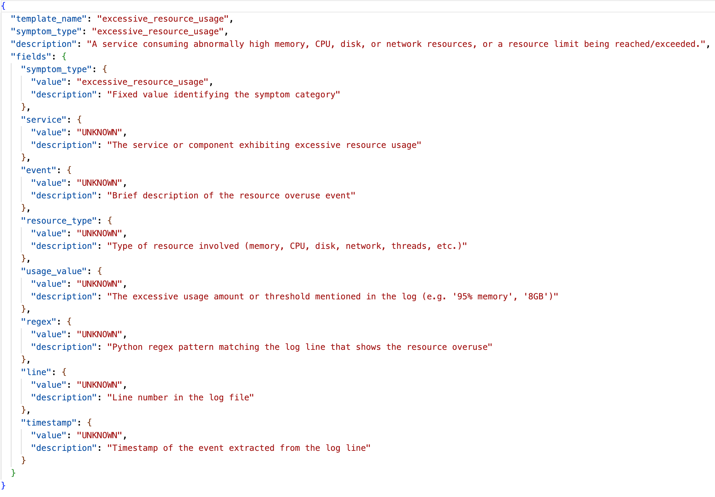
Challenge 1: Automatically identify symptoms from logs
Our approach: Template-based LLM

Slide 7
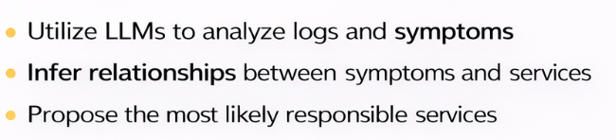
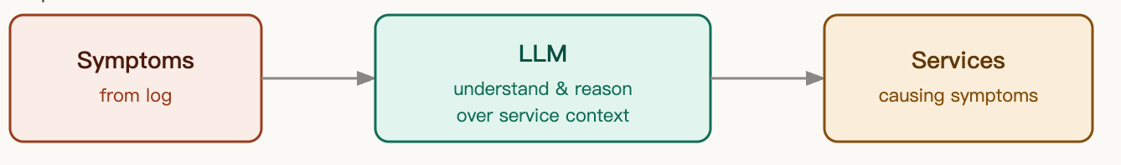
Challenge 2: Automatically connect the symptom with root-cause services
Step 1:

Slide 8
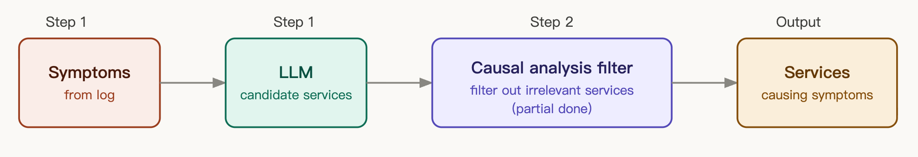
Challenge 2: Automatically connect the symptom with root-cause services
Step 2: Filter out invalid connections by casual analysis

Slide 9
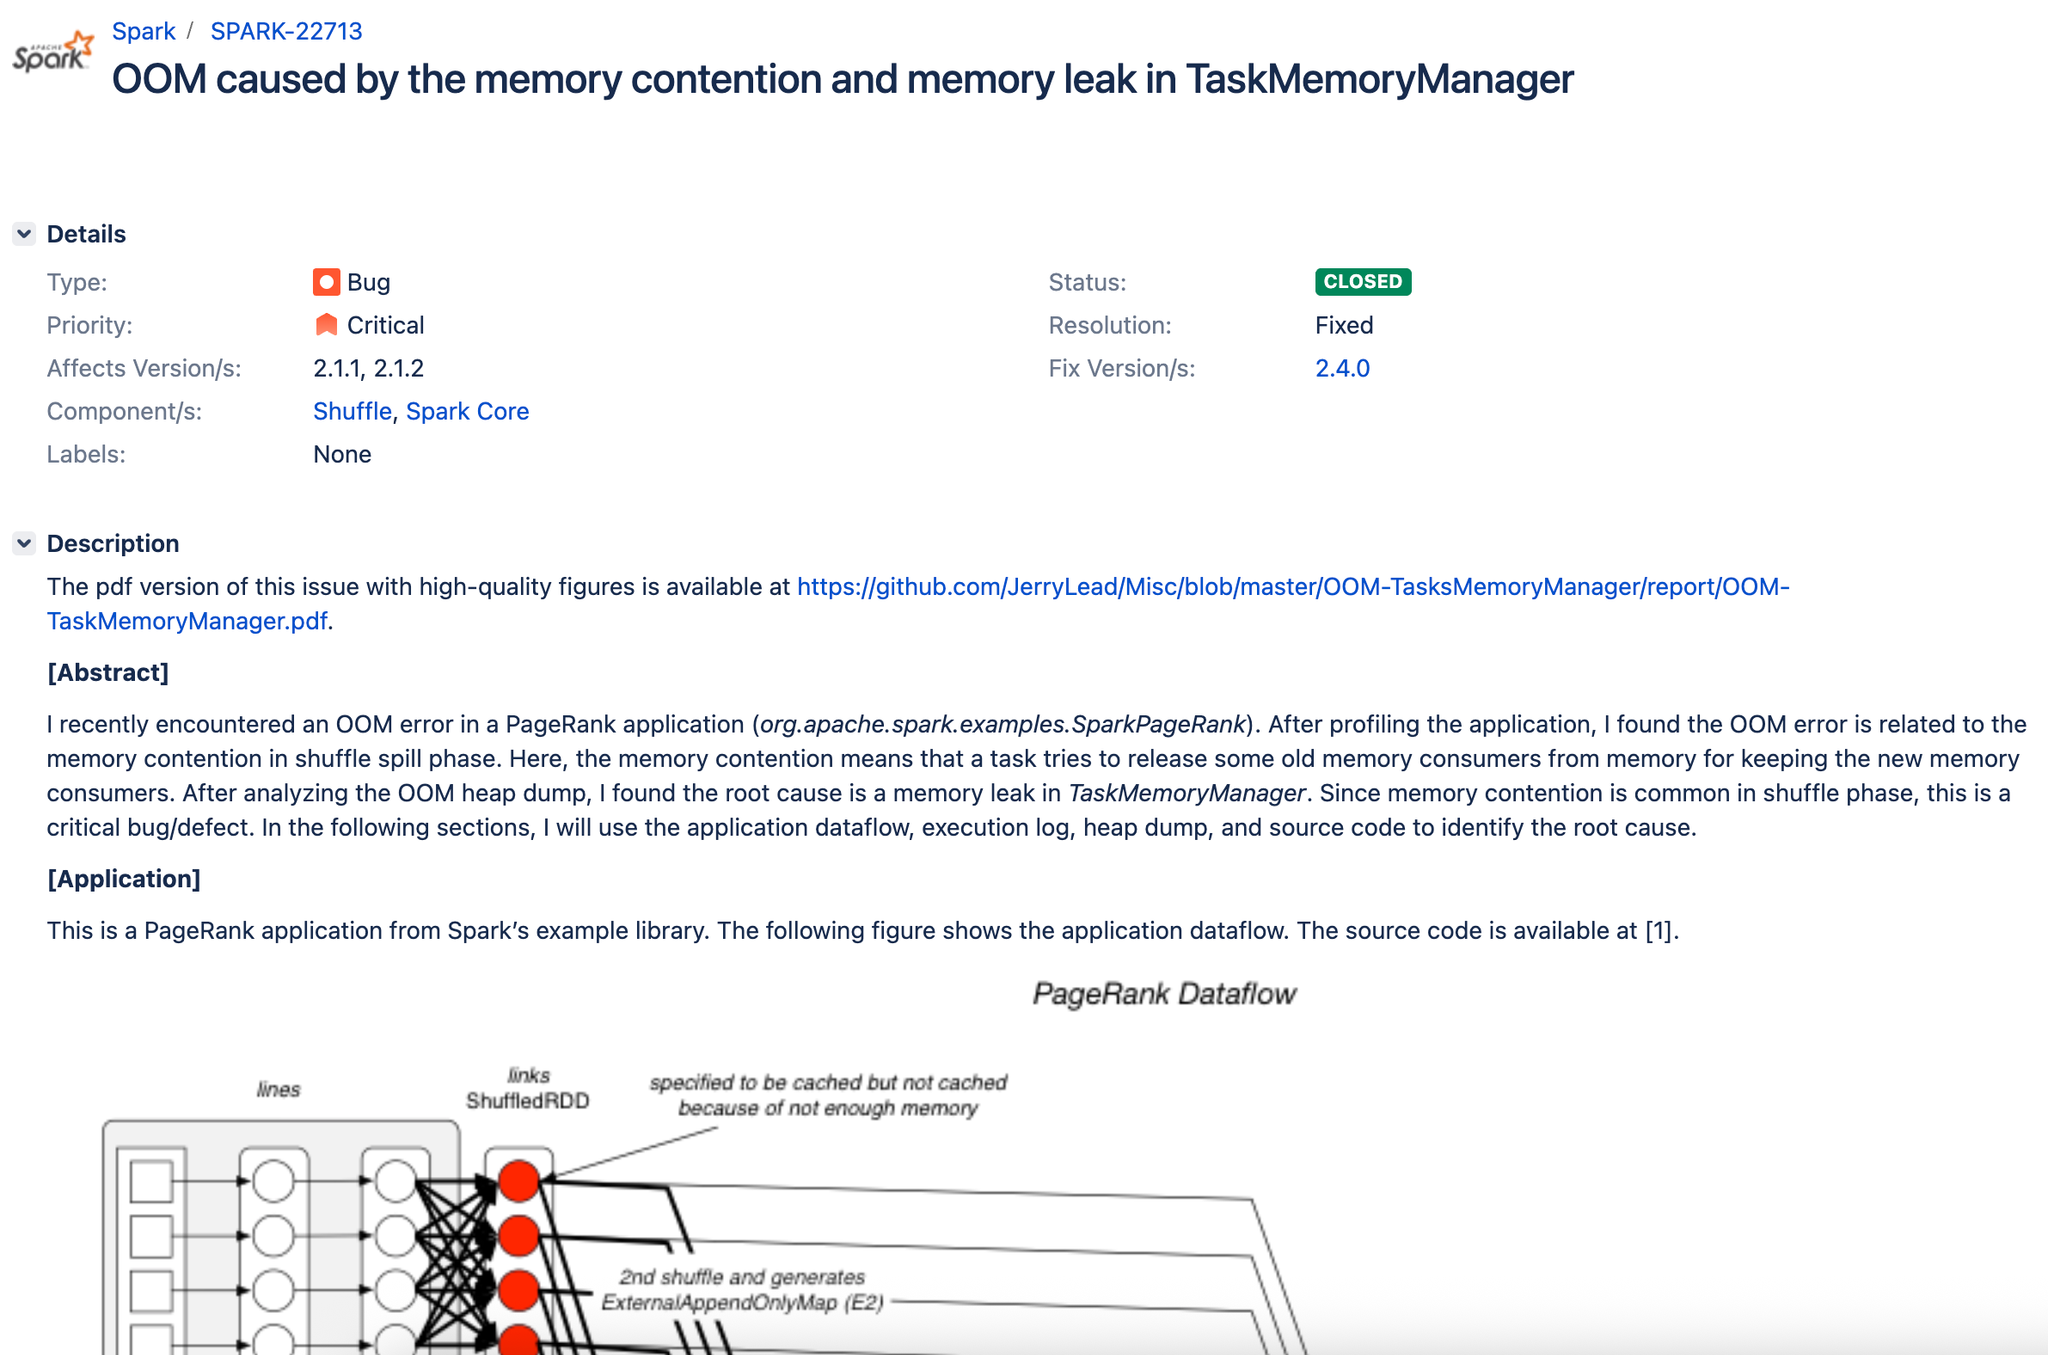
Preliminary Result

Slide 10
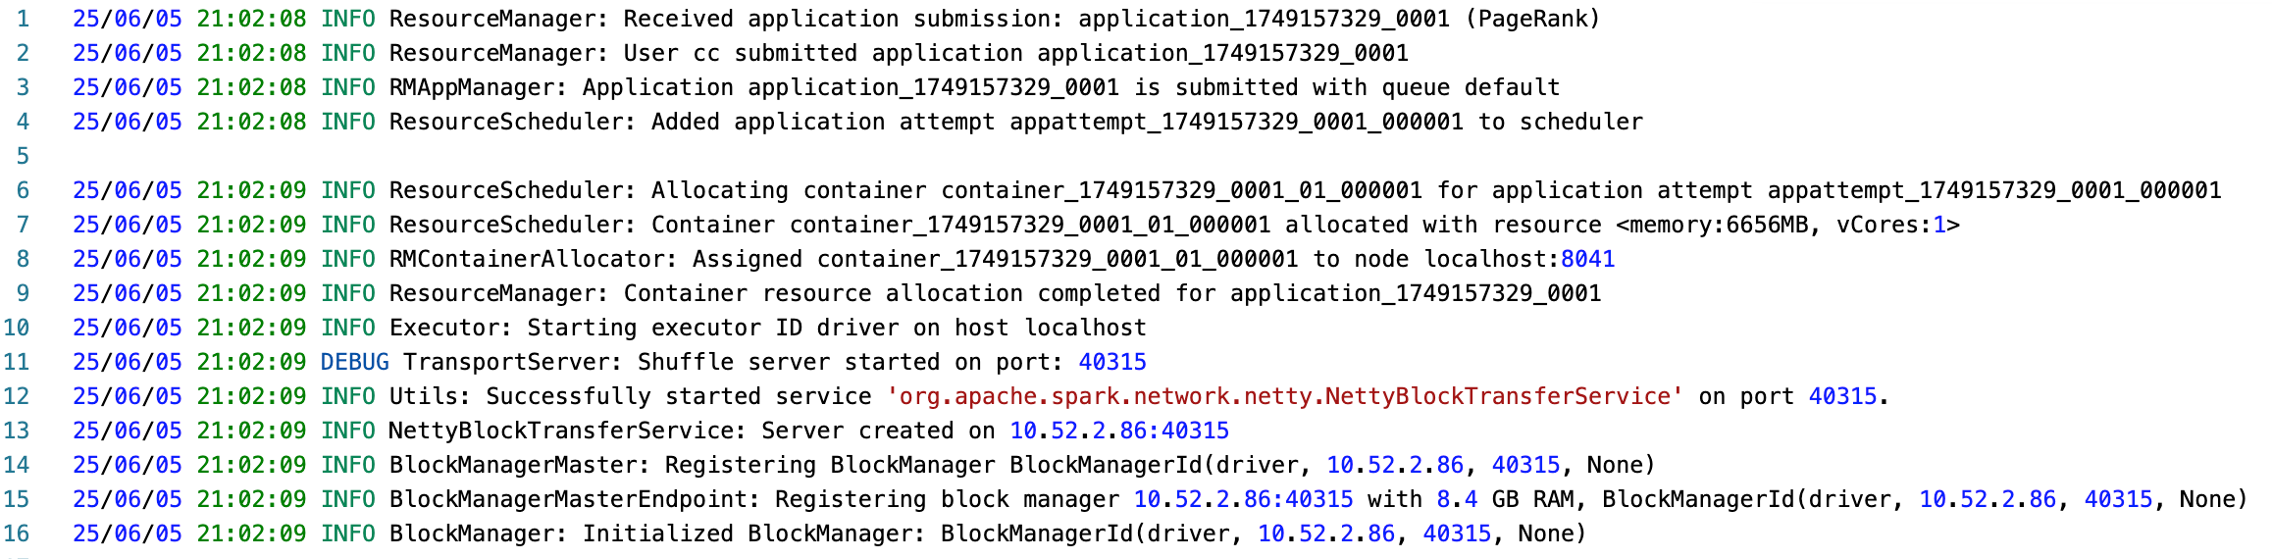
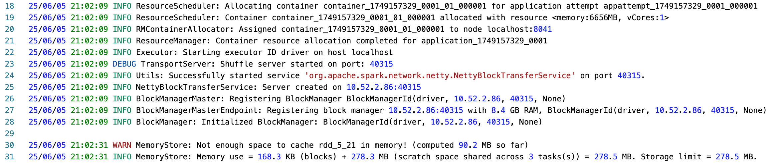
Preliminary Result

Slide 11
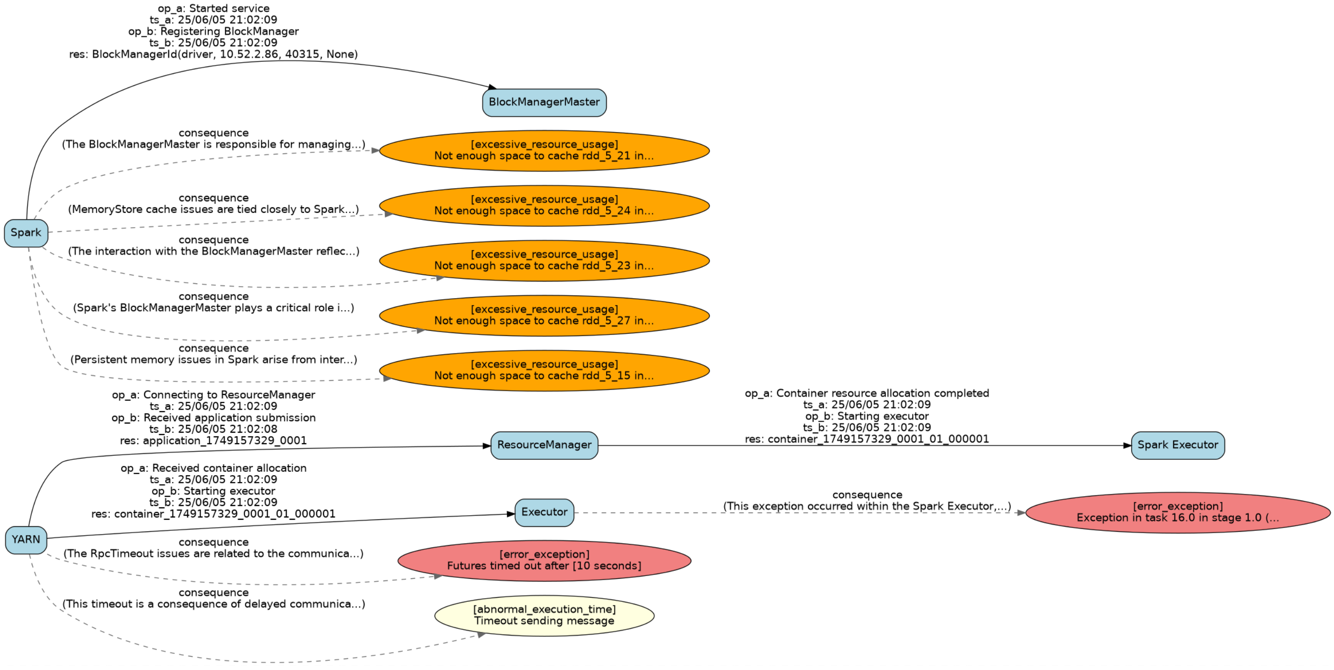
Preliminary Result
Excessive resource usage
Error exceptions
Abnormal execution time

Slide 12
Next Step
Different service and versions could lead to inconsistencies in the low-level abnormal events.
Build higher-level representation of performance data that hide inconsistencies

Slide 13
Thanks

